Slide 1
CAMPUS ENGAGEMENT
How to Make Friends and Maintain Relevance
(and Student Funding)

Slide 2
OUTLINE
-Challenges-
-Adapting to Changing Needs-
-Outreach and Visibility-
-Tracking Engagement-
-Campus Programs & Organizations-
-Challenges from “Above”-
-Campus Safety and Communications-

Slide 3
Challenges
Remaining Relevant in a Changing Mediascape – Terrestrial, Online, Podcasting, Social Media, Content Creation
Visibility, Tracking Engagement and Student Opportunities
Scrutiny from Above – Government, School Administration and Student Fee Referendums
Space Negotiations
Campus and Community Balance & Access
Others?

Slide 4
CFRU VOLUNTEERING VIDEO
https://www.youtube.com/watch?v=WkQyVRSWISM

Slide 5
From Radio Station to “Media Centre”
-Upgrades to Audio Production Facility (monitors, popular software, microphones, consoles/mixers, sound treatment, midi controllers, portable recorders real and virtual instruments) *music and media dept tours
-Social Media Lab
-Workshops (beat-making, interviewing, podcasting, event, promotion, marketing, community organizing, live sound, silk-screening, etc) and special interest events (Synthposium, theatre dept support, Campus Friends’ Burning Questions)
-support partnerships for campus orgs (Campus Friends, OPIRG, CSA, MSA) *including loanable equipment (PA, mics, recorders, etc) – space, production tools & help, recording
-Archiving & Storage (have organized space to offer)
-Changing organization name/ID across campus (especially in fee documentation)

Slide 6
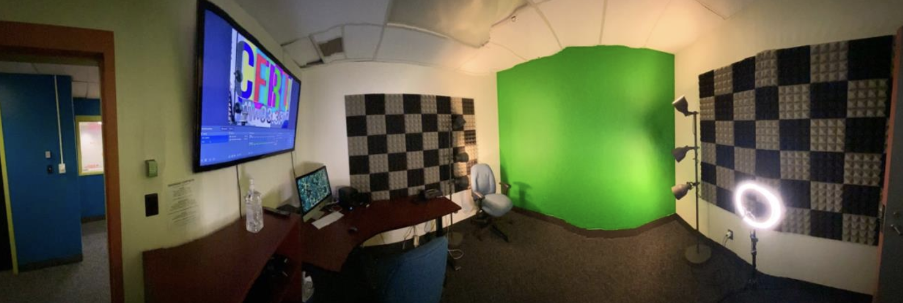
SOCIAL MEDIA LAB

Slide 7
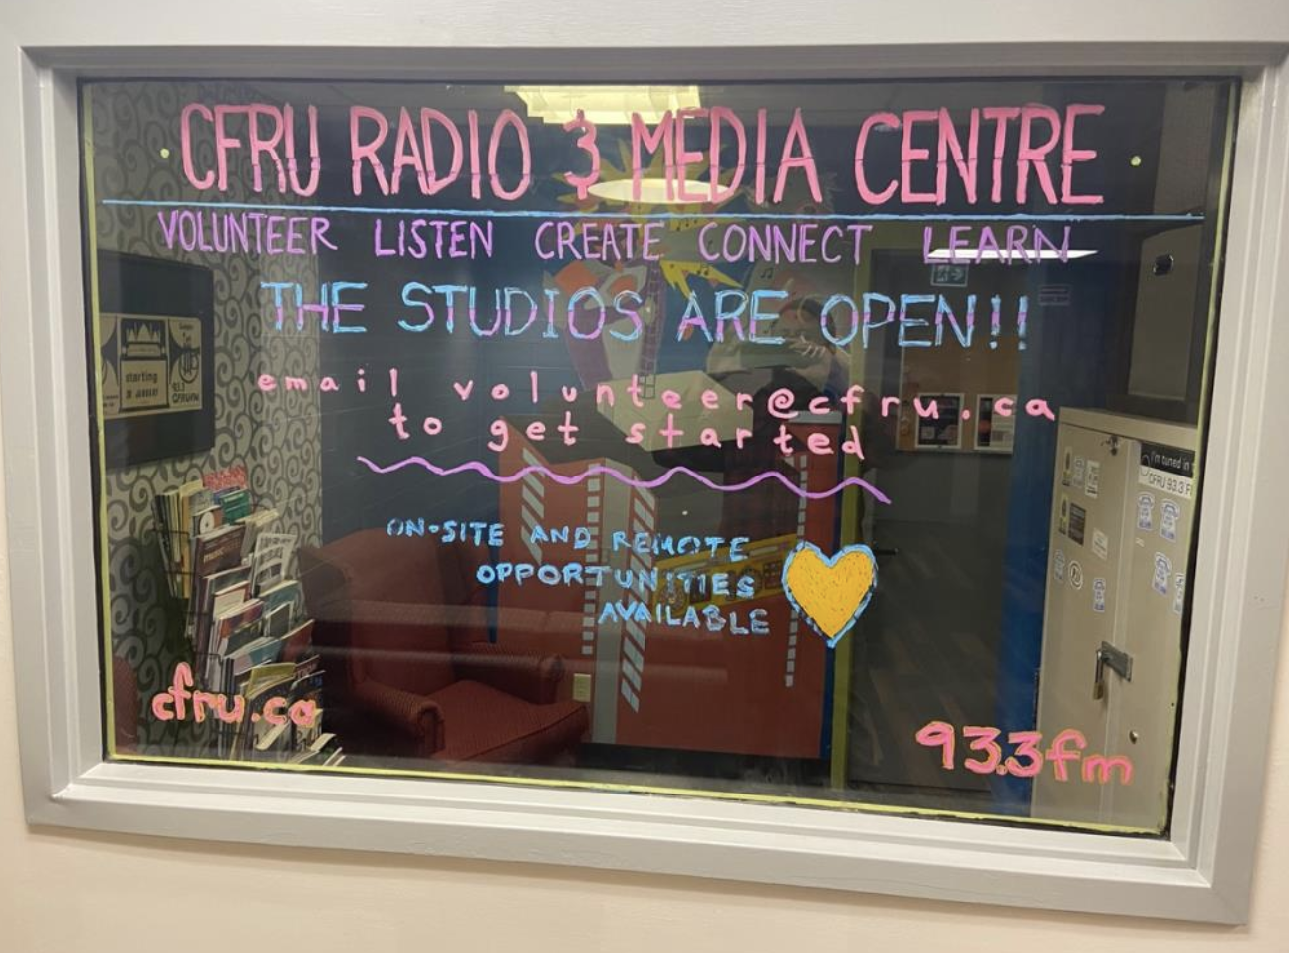

Slide 8
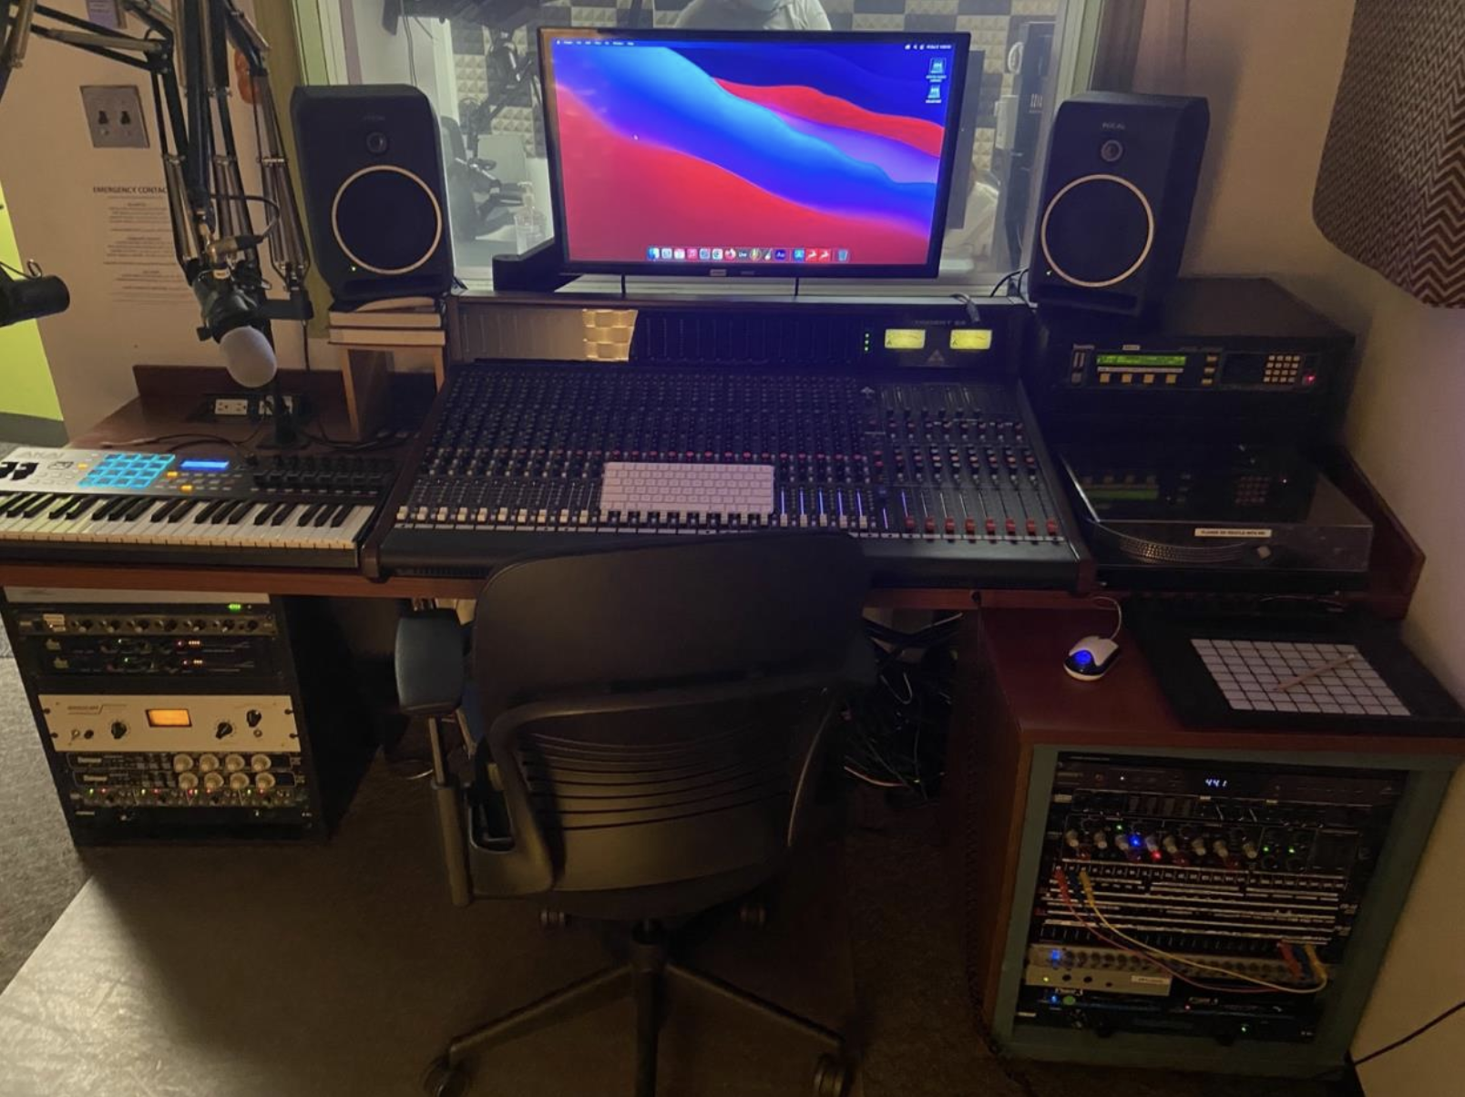

Slide 9
Remaining Relevant in a Changing Mediascape
The CFRU LIVE Success Story (aka The Green Screen Dream Team)
-student input on BOD, Tech and Finance Committees
-modest beginnings with modest gear (webcams, OBS, multichannel mixer, stage microphones)
-gradual investment in better gear as BOD sees results
-encouraging team development and independence
-connecting campus interests (music department, media courses, on-campus live music, collaboration with existing show hosts)

Slide 10
CFRU LIVE VIDEO
A success story of student engagement (produced by the students themselves)
https://youtu.be/TuyWAYkJibw

Slide 11
Outreach and Visibility

Slide 12
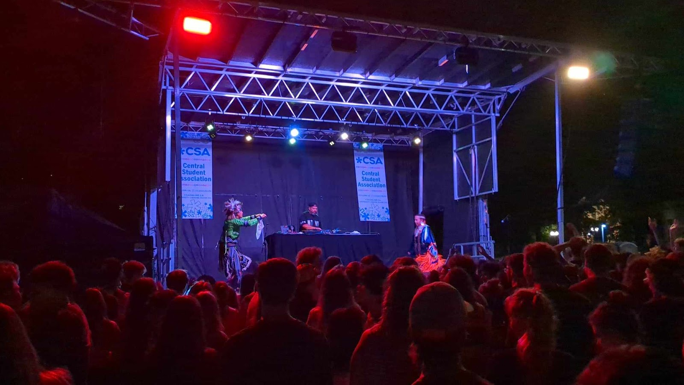

Slide 13
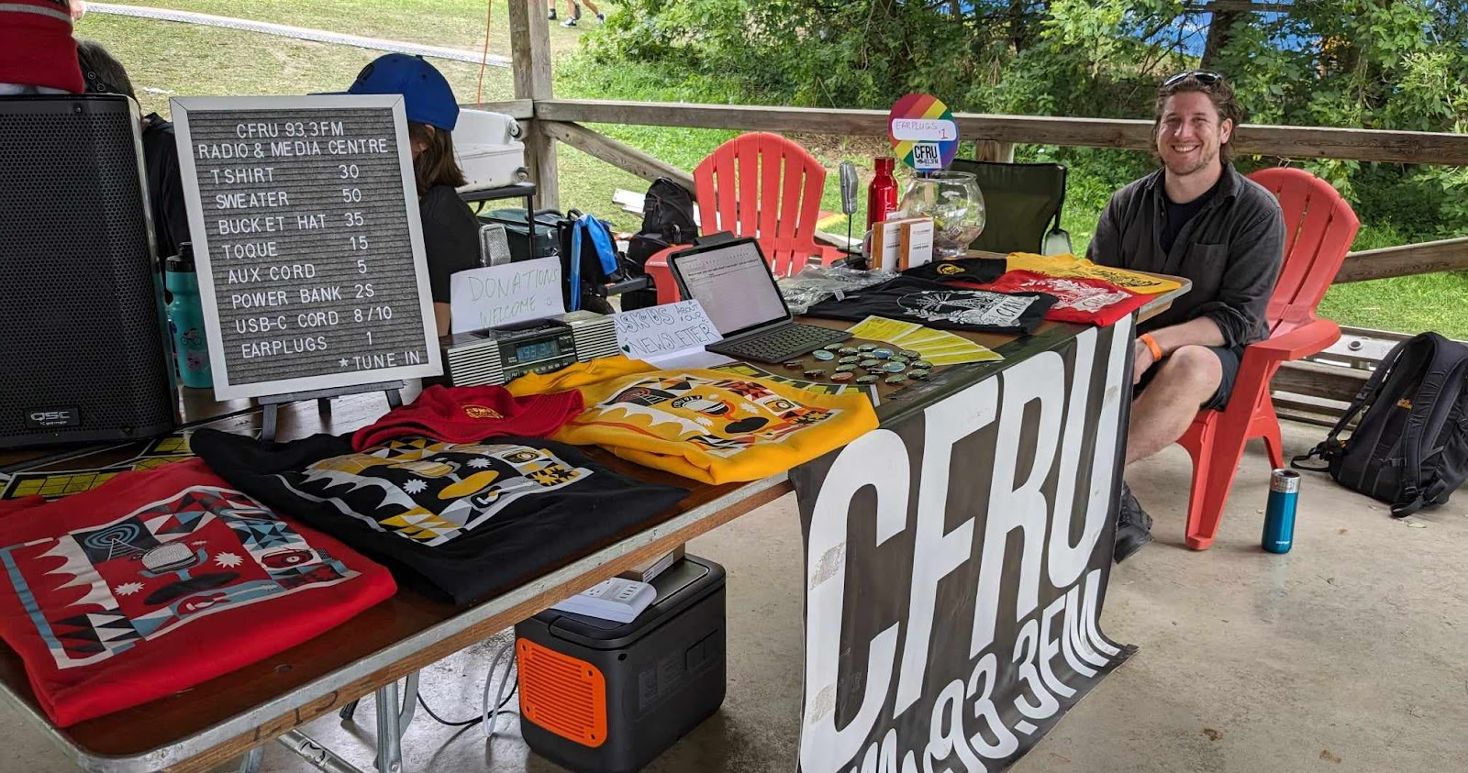

Slide 14
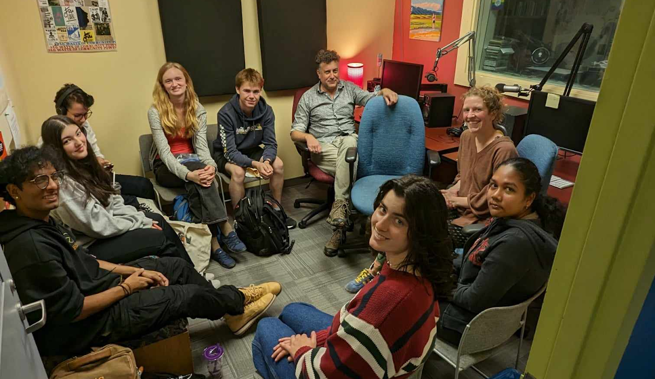

Slide 15
Visibility & Tracking Engagement
Marketing and outreach initiatives and ideas (O-Week CSA event collabs, **clubs days**, residence stuffers, bus ads, remote broadcasts around campus, merch giveaways, sports??)
Cloud-based sign-up sheets
Video monitor content across campuses (bright, fun, vivid, diverse representation)
Co-presentations & sponsorships, free campus org PSAs, outreach team)
Testimonials (historical/alumni, and following new initiatives)
Organize yearly at least, preferably by term if possible
Start early (connecting with new students and prospective students (high school, elementary, even early education)
Maintain visible history in your facility
-Campus Library archives (safe storage of archival materials ongoing & help with documentation and organization)
-Show history on the walls of the station & look for opportunities to exhibit elsewhere
-Anniversary “memorabilia drive” collect stories and from the community

Slide 16
Connect with Campus Programs and Instructors
  -Look for groups on campus who have a mandate to connect students with community and/or media production
  -Project Serve & Volunteer Opportunity Hubs (Student Volunteer Services)
  -Campus Friends
  -Class talks & tours
  -Outreach with specific class projects in mind (podcast projects, music and media production classes, library archives & history programs)
  -Programs & podcasts to showcase notable work around campus (interviewing professors, experts, showcasing student music)
  -Careful with academic credit and student fee restrictions
  -Promote your archiving capabilities (collected campus knowledge and history)
  -Student scholarships?

Slide 17
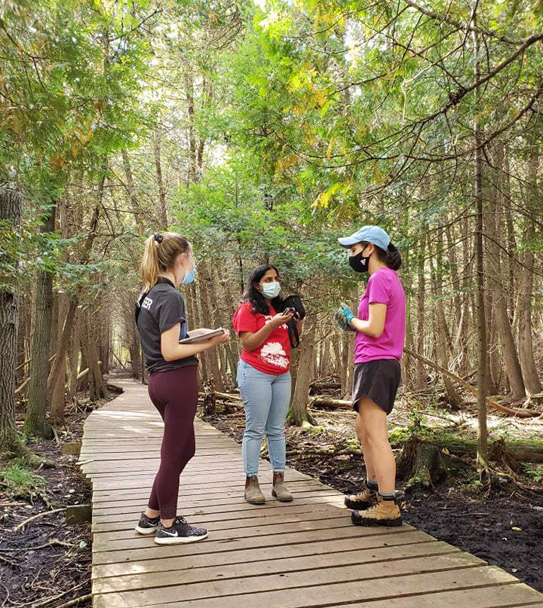
PROJECT SERVE
“CFRU has contributed to the success of Project Serve in countless ways over the years! Project Serve is a single-day event for University of Guelph students, staff and faculty, aimed at providing barrier-free volunteering opportunities and challenging folks to connect their experiences in a tangible ways to what they are learning as scholars and as citizens. CFRU has brought creativity and passion to ensure that these single-day events are not forgotten! Your involvement has meant that Project Serve can reach more people across our community, and allows participants to have more reflective experiences thanks to the thoughtfulness your team brings to planning.
Aside from Project Serve, we are also endlessly impressed by the way CFRU makes volunteering accessible for everyone! I do not know of any other organization in our community that will accept any willing volunteer, no matter what it is they want to contribute. If someone has an interest, CFRU finds a way to let them express it through volunteering their time!”
PHOTO: Project Serve students at our Hanlon Creek Boardwalk volunteer day. CFRU had lent out portable recording equipment and trained a handful of volunteers on how to use the equipment and the basics of interviewing. Our students then interviews the 40+ students in attendance about why they signed up to volunteer and what they were learning and enjoying about Project Serve. CFRU then turned these audio clips into a short radio program!

Slide 18
CAMPUS FRIENDS
CAMPUS FRIENDS provides adults with developmental disabilities the opportunity to experience student life with support from University Of Guelph volunteer mentors enabling each individual to discover their talents and strengths as adult learners
On campus one day a week, this 3-year program focuses on engaged learning through a variety of university based activities.
A typical day is a combination of opportunities related to academics, volunteering, athletics/recreation, special events, project based research initiatives, networking/student interactions
CFRU has consistently been a valued collaborator open and willing to increase the visibility and voice of CF students and mentors through a variety of shared experiences EXAMPLES: Burning Questions Event, CF Graduations, etc. On a weekly basis, CF students & mentors are invited to participate as on air hosts & editors (the CF Program)
CFRU Radio plays a vital role in the engagement of CF Students. Indeed, this partnership has regularly been identified by students and mentors alike as a key highlight of their tenure with CF!

Slide 19
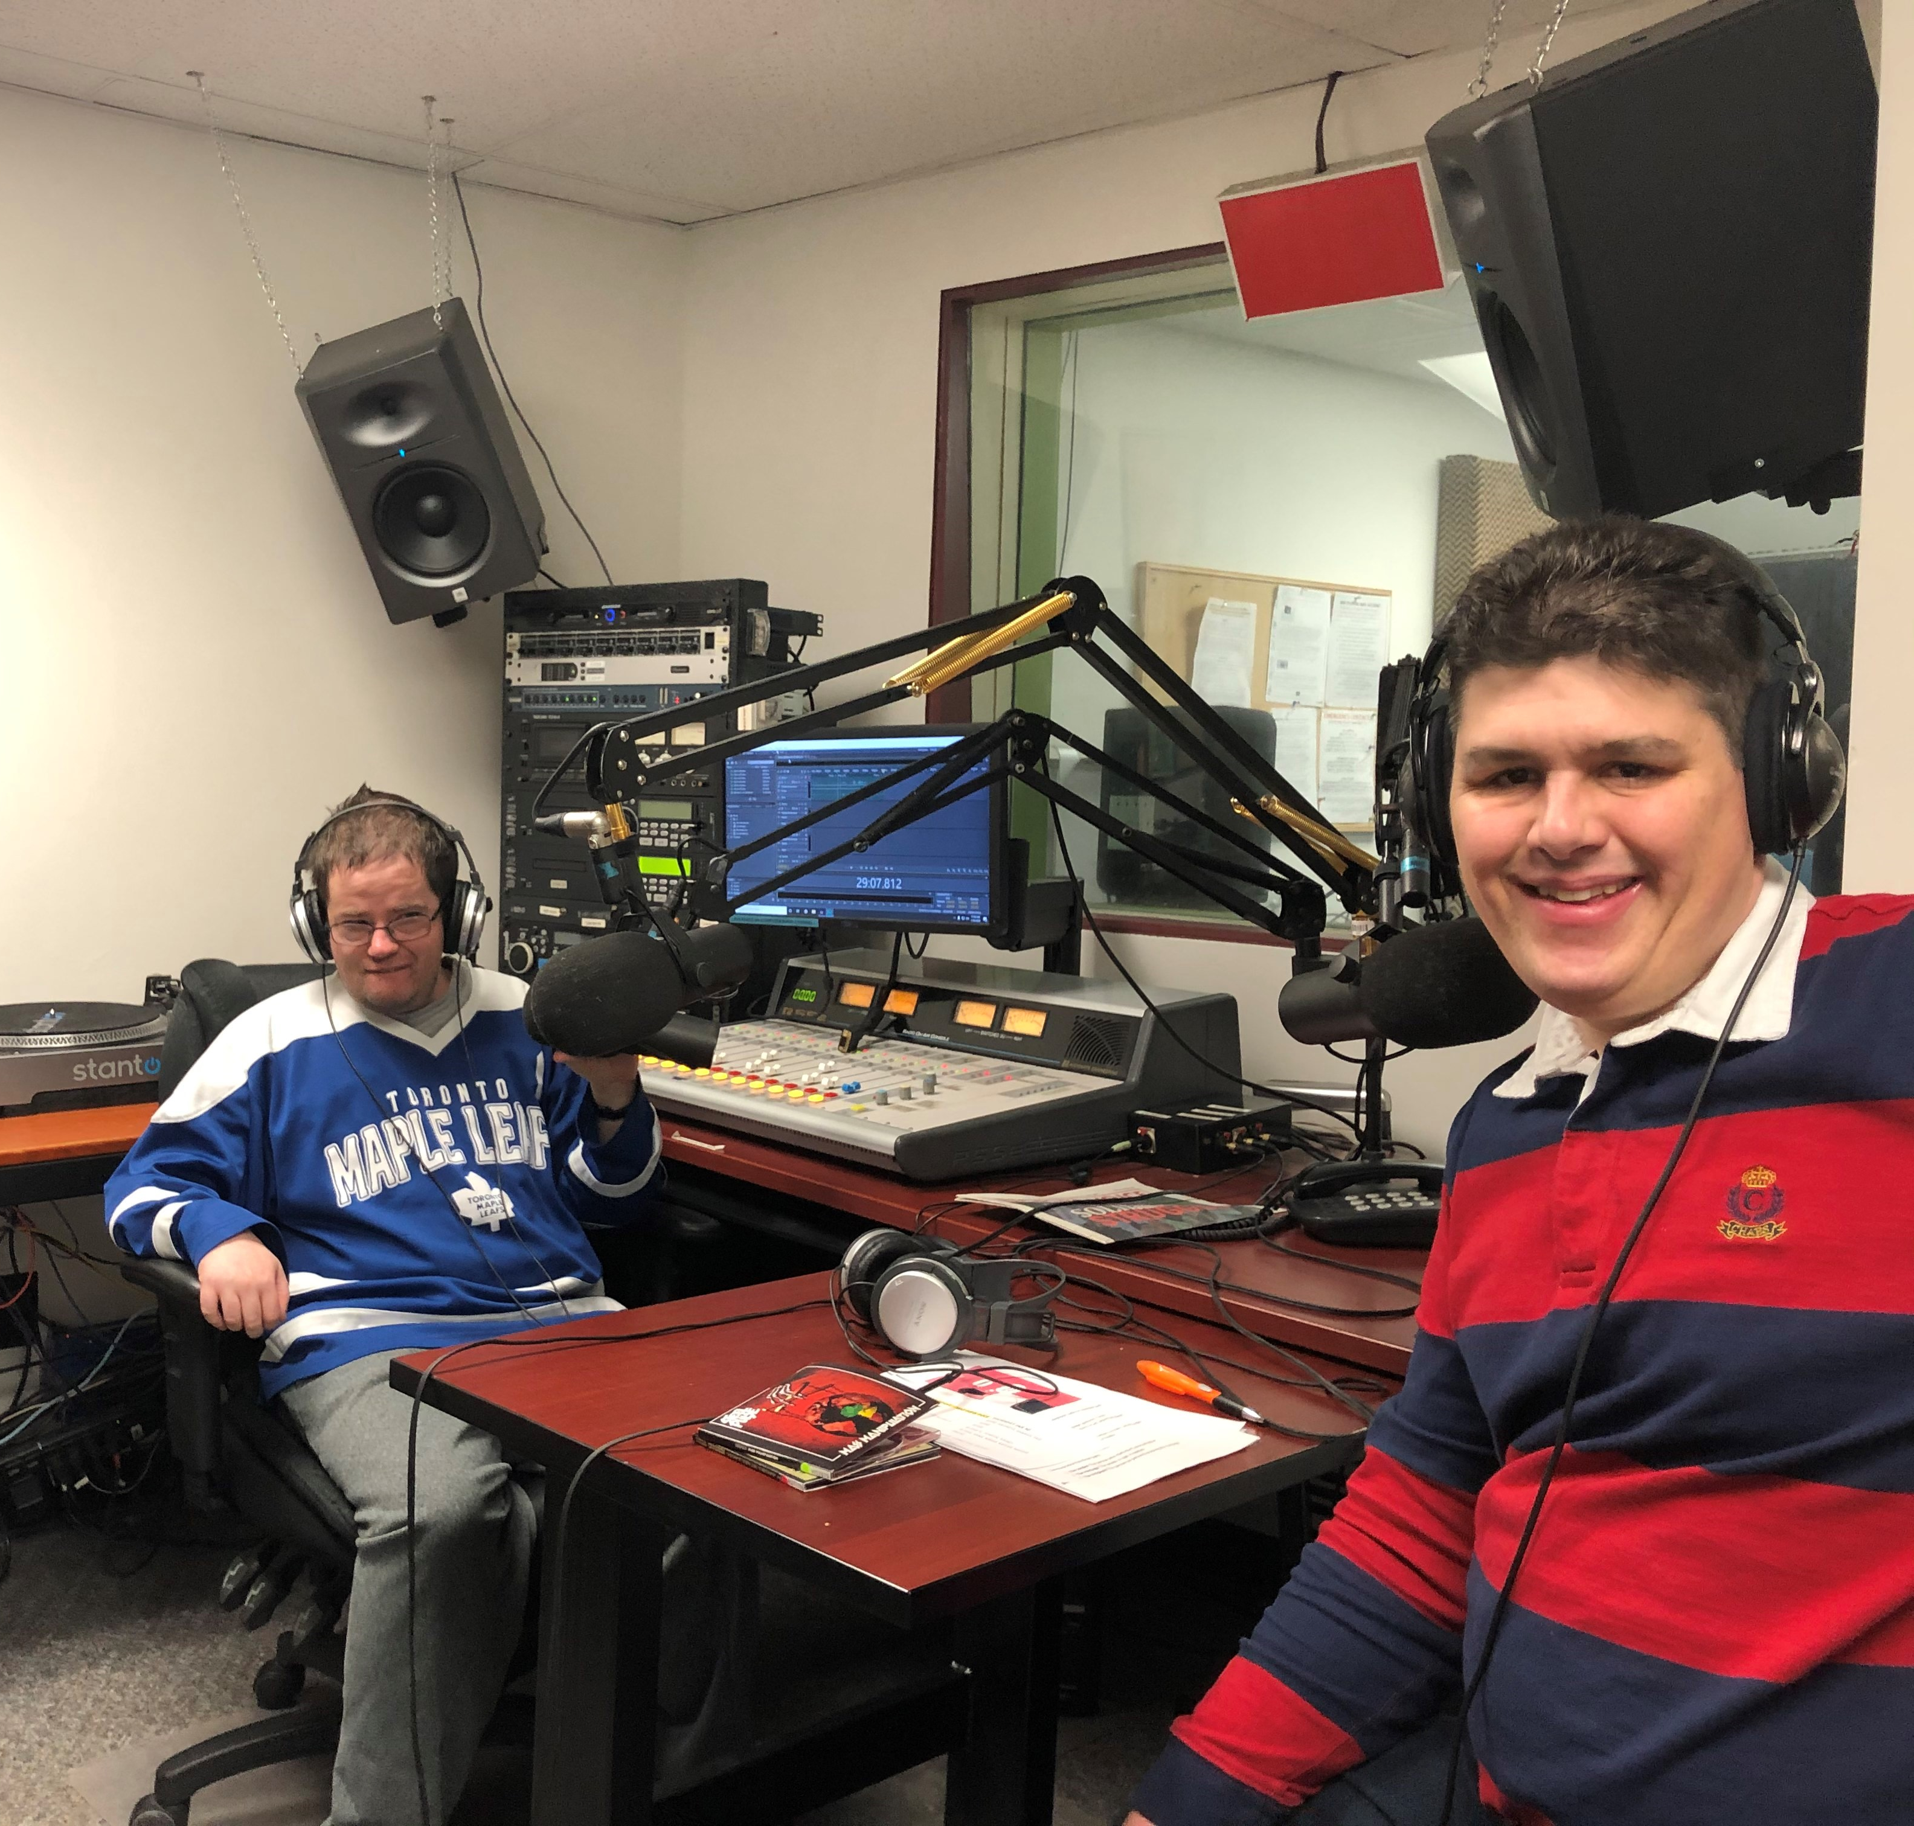
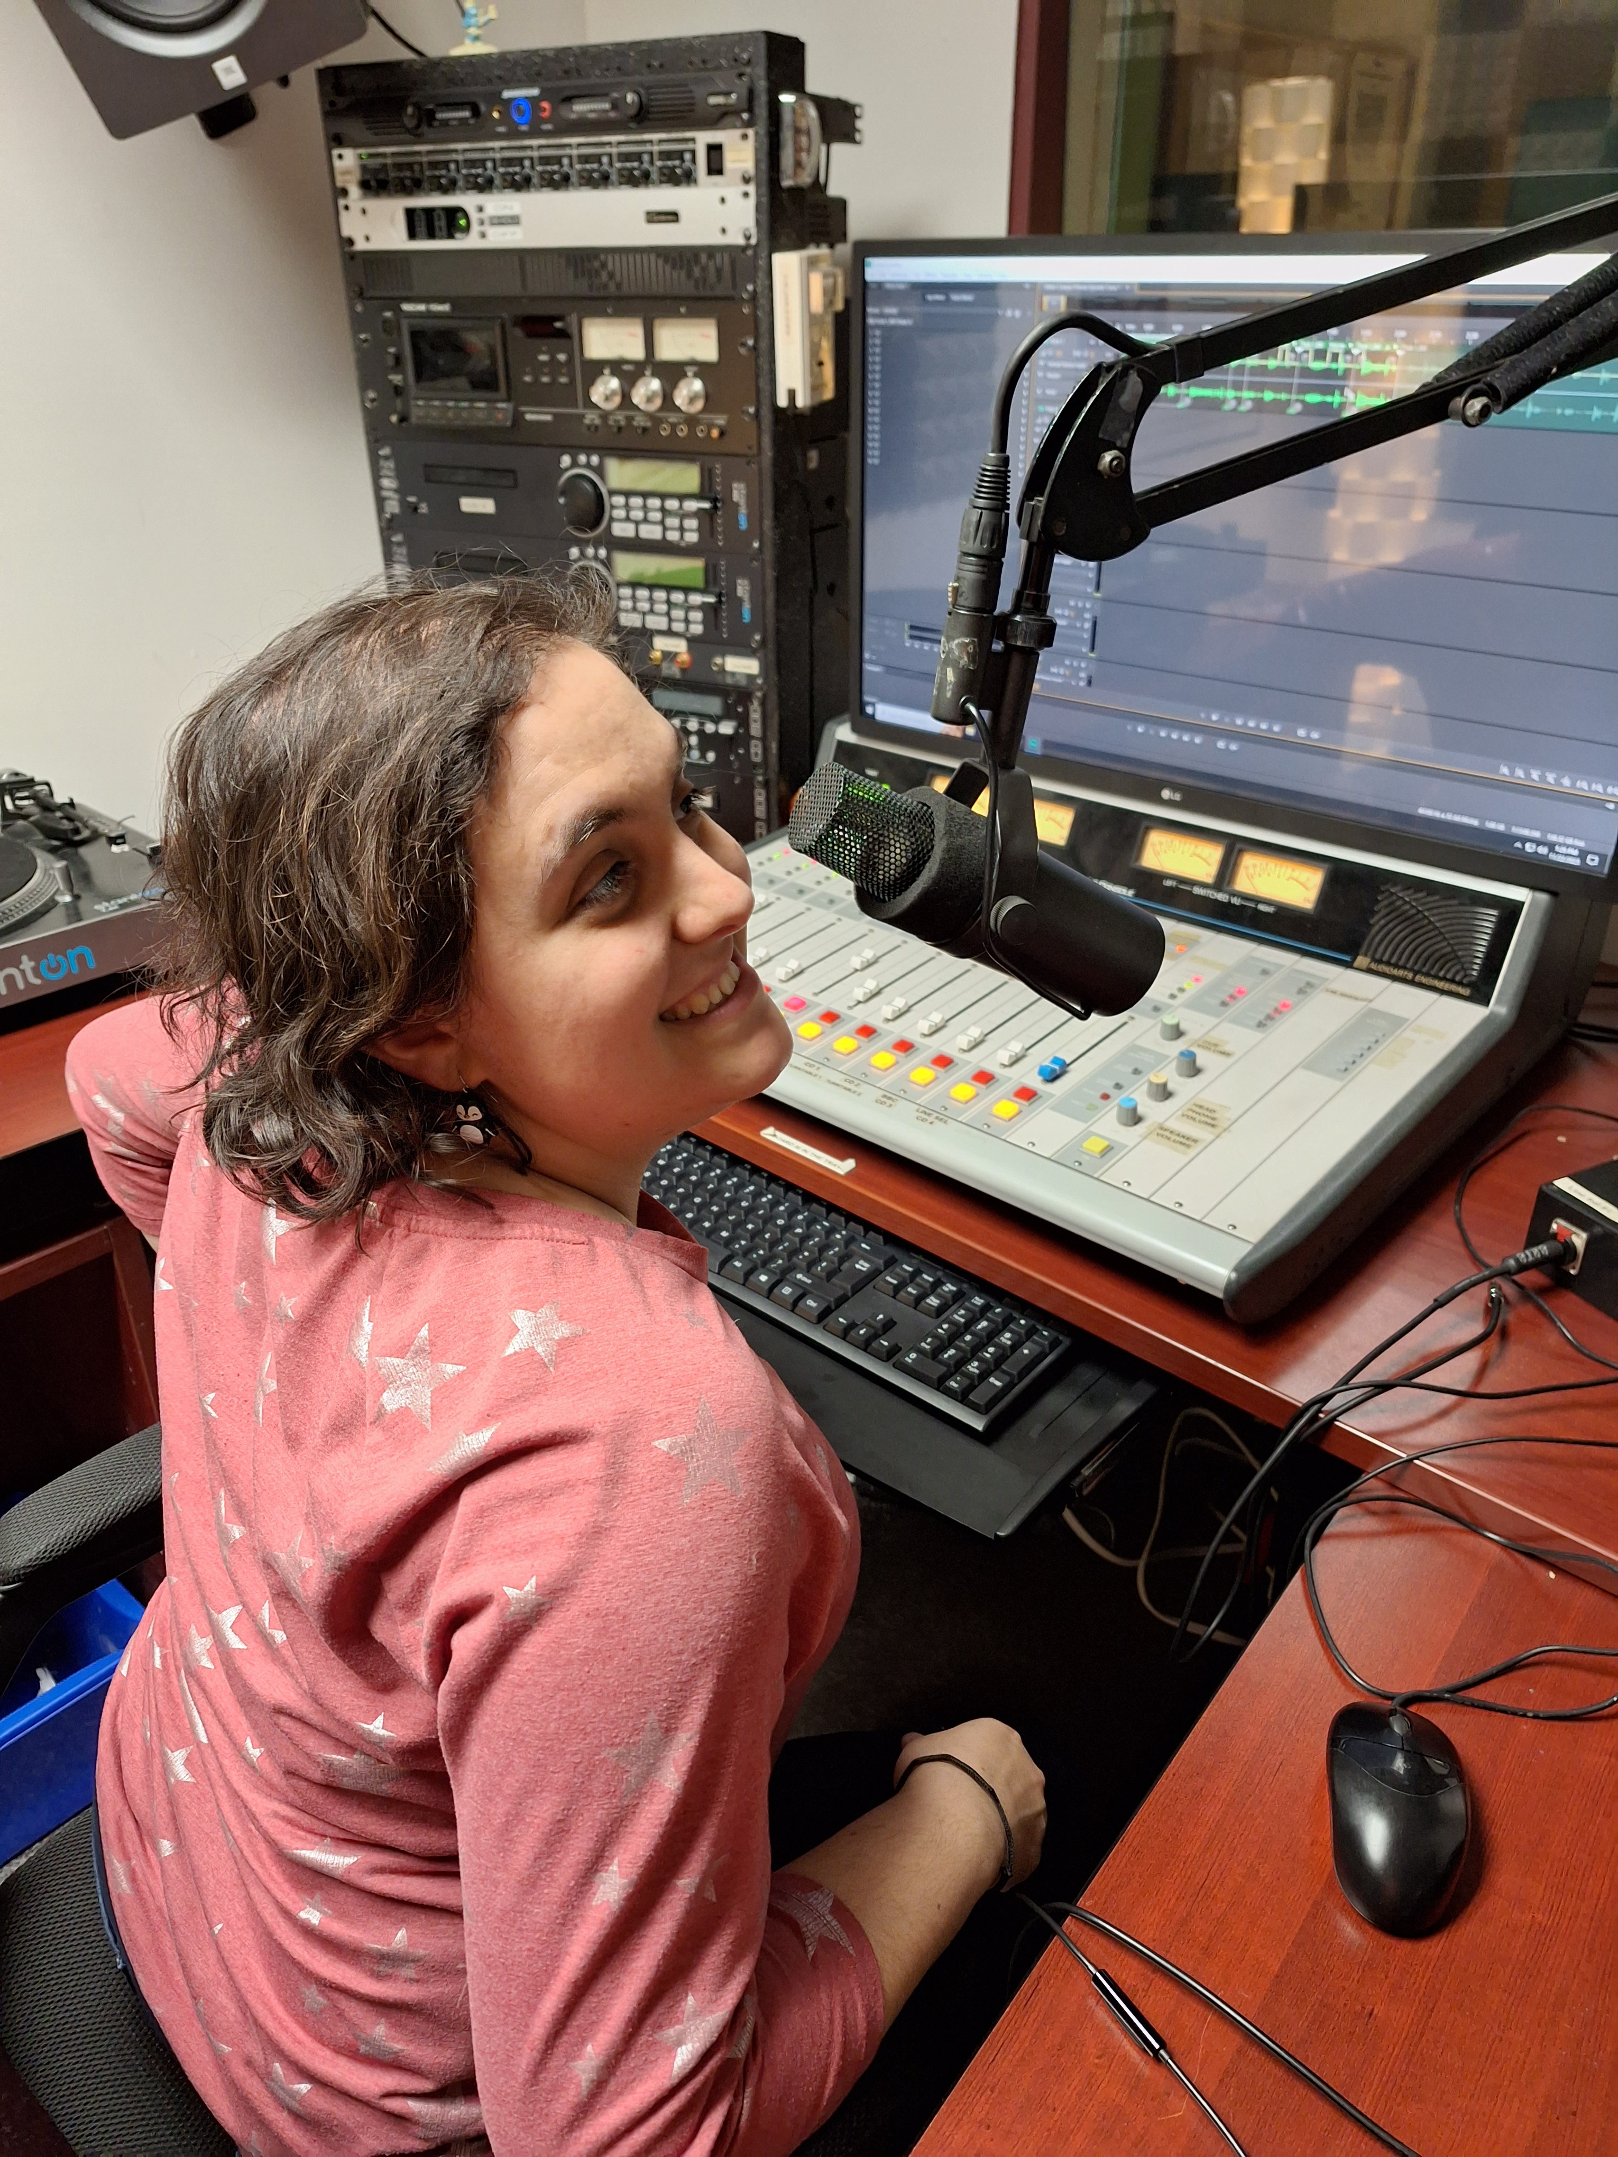
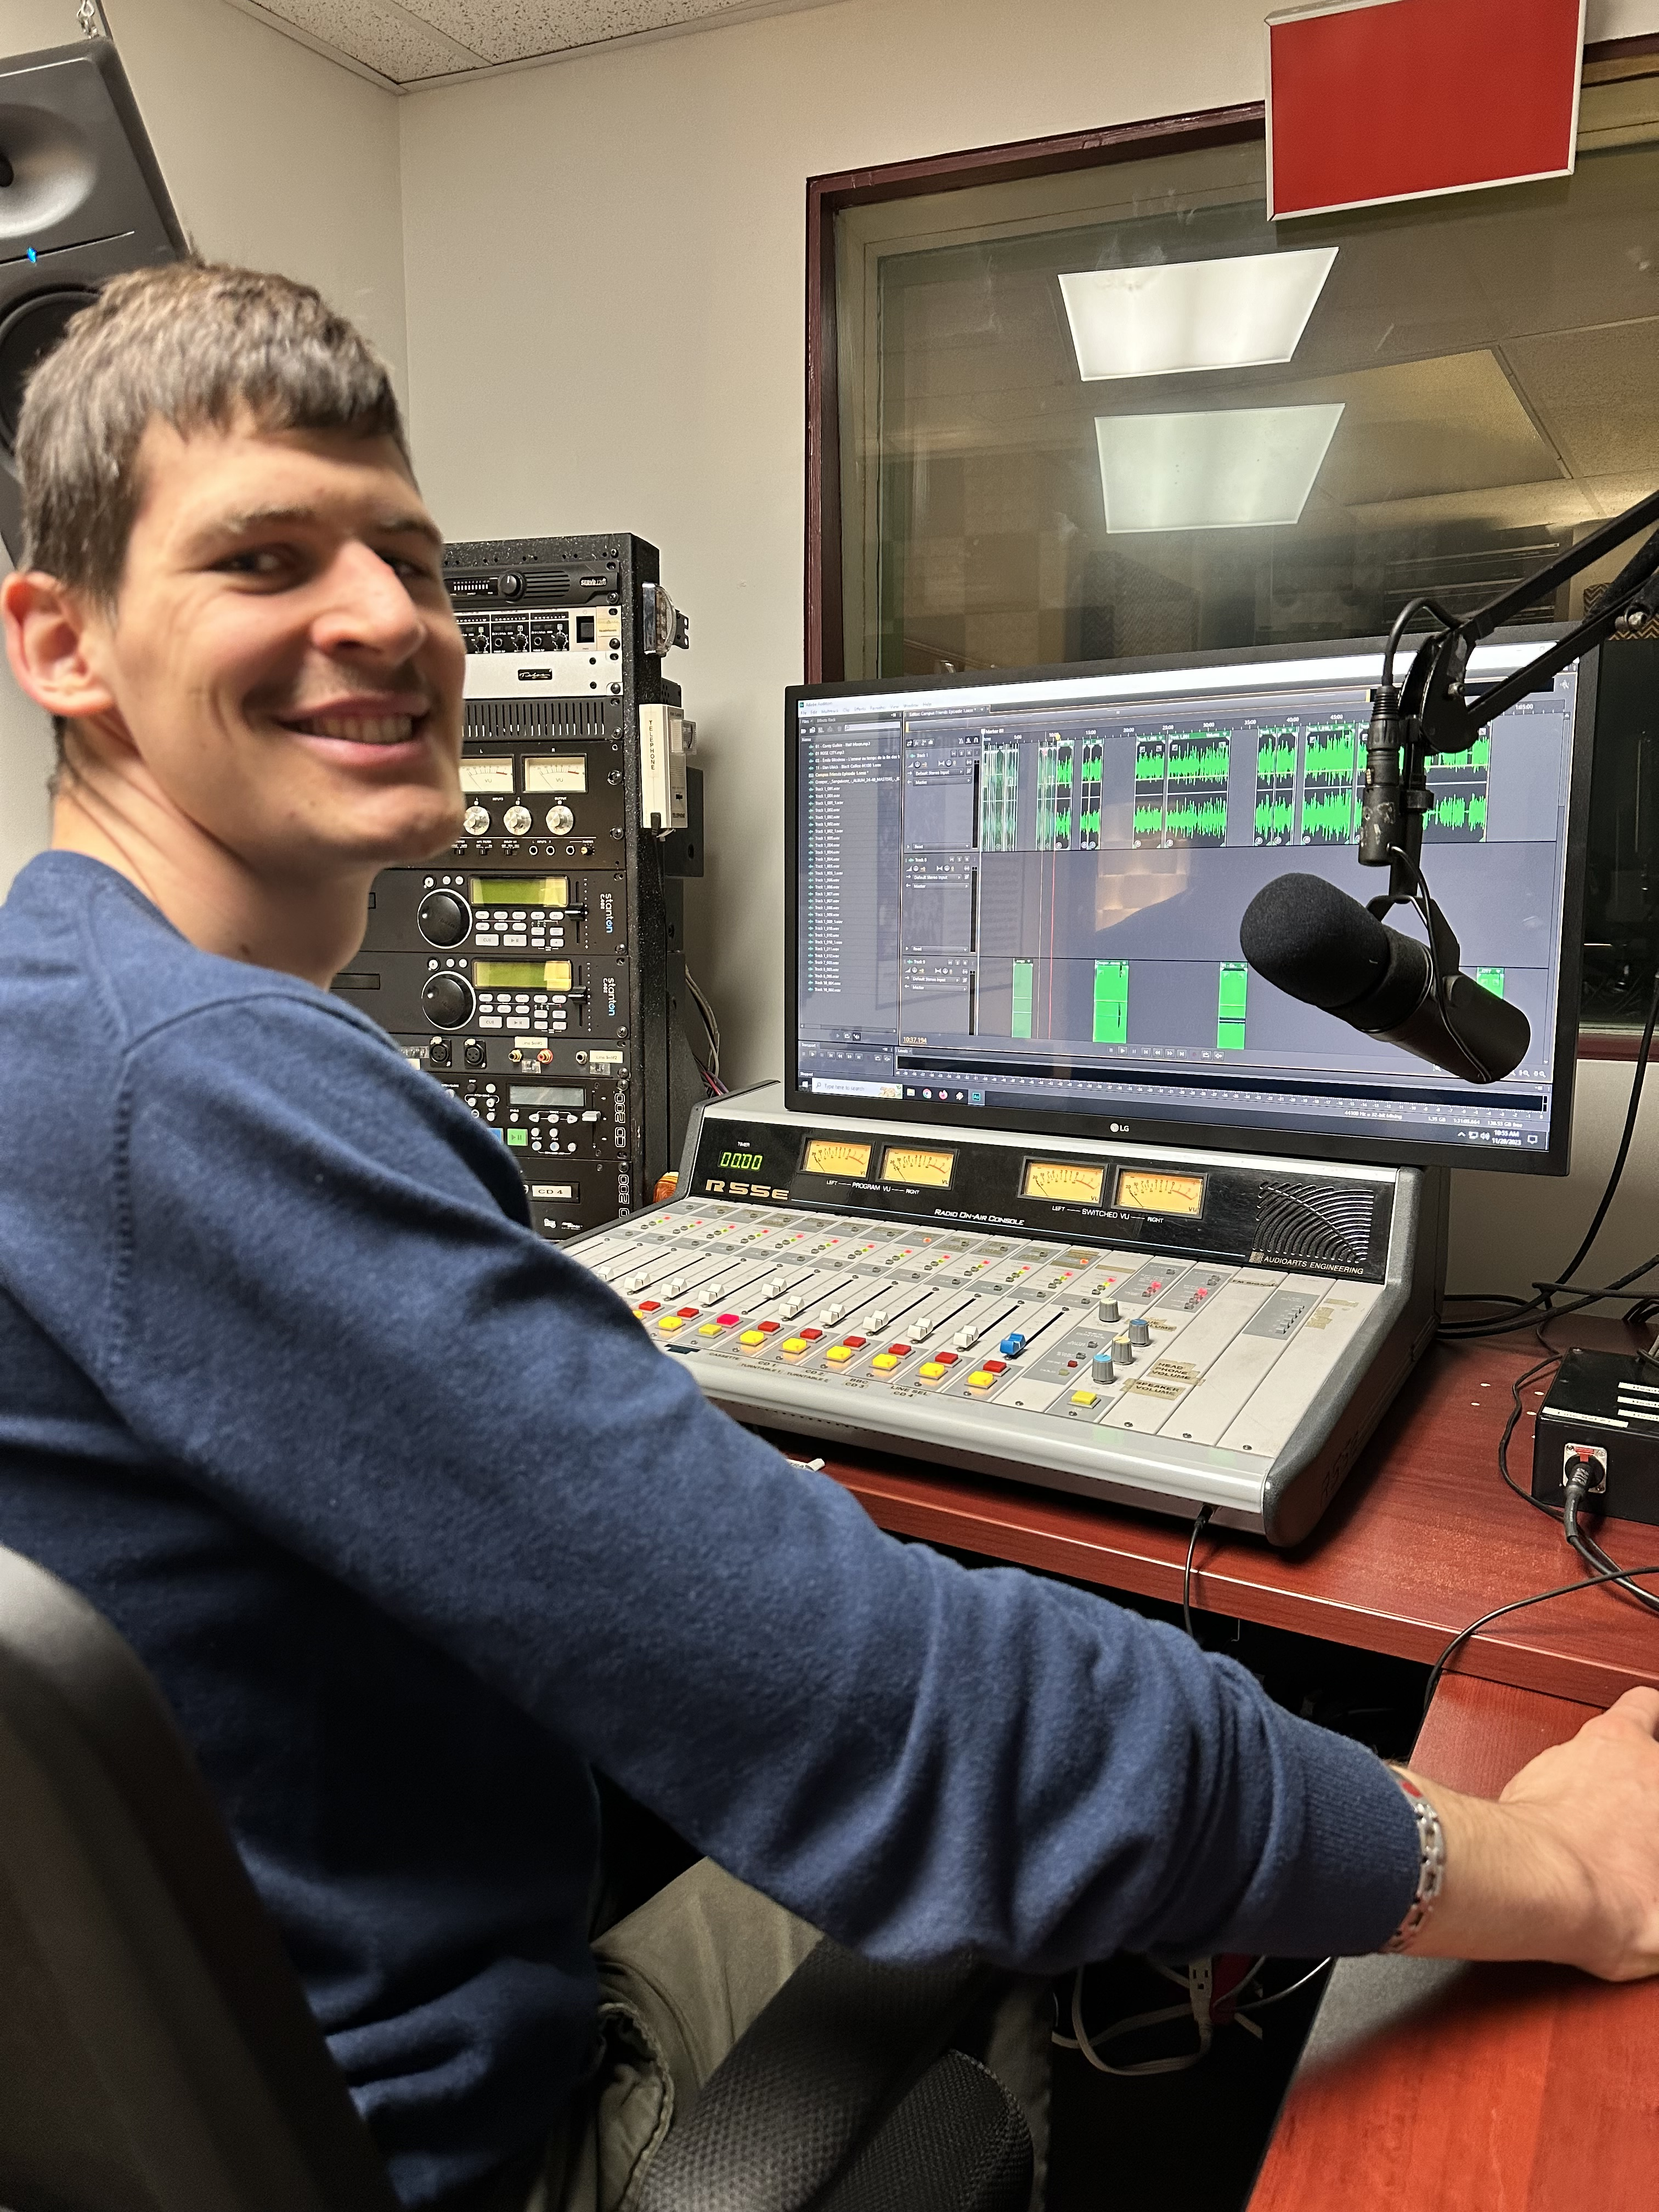

Slide 20
NICOLO’S CAMPUS FRIENDS VIDEO
https://youtu.be/uA2SmRaZsQ8

Slide 21
Student Opportunities (Employment and Experiential Learning)
Student Staff Positions
-Create mentorship arrangements with various department heads to cover varied aspects of media and communications
-Help with the workload of all of the initiatives listed above
*Student Liaison
*Events Assistants
*Local Music Coordinator
*Website Accessibility Assistant
-Specific outreach across campus (program listservs and coordinators, clubs, etc) *know policies/bylaws around religious or political groups
-Term-based contract length
-Look for school & government funding subsidies (& know the limitations)
-Track successes (testimonials, reports) and challenges, adapt
-Create certificates, write letters of reference

Slide 22
Challenges from “Above” – Government, School Administration and Student Fee Referendums
The Student Choice Initiative (booo)
Student Fee Committee Report (See shared document)
Referendums
Space Agreements

Slide 23
Strategies for Dealing with the Above
-“Staging” for a tour – a good yearly practice
-Face-to-Face meetings
-Non-antagonistic engagement (while remaining true to mandate and journalistic values) – be buddies with your Student Association if possible
-Regular engagement with Student Association - make them PSAs and Ads, cover elections, interview/spotlight new leaders upon election
-Have previous/historical leases, contracts & agreements ready and available
-Have info about notable alums from your station at the ready - Where Are They Now?
-Be ready to name the “marketable skills” that students learn through your station (communication, interviewing, media/social-media literacy and responsibility, anti- oppressive practices, collaboration, responsible media/content production, technical literacy and skills, marketing and outreach, community building, etc)
-have a lawyer available (agreed upon by staff and board) who can help navigate when necessary - a good thing to review at first BOD meeting after AGM
-Maintain student involvement on BOD and committees (especially finance)

Slide 24
Campus Safety & Important Notices
connect with campus emergency systems to assist with communications where possible
explain the value of terrestrial radio in emergency situations (vs cellular signal, etc)
offer production services for campus news and important communications
Support campus and community mental health (psas, programming, etc)

